Slide 1
Big Data

Slide 2
What is big Data?
Big data usually includes data sets with sizes beyond the ability of commonly used software tools to capture, manage, and process data within a tolerable elapsed time.

Slide 3

What lead to Big Data?
Advancement in storage technology
Affordability of Smart Phones
Computing ability (Cloud)

Slide 4
Applications: What makes Big Data valuable?
Big Data allows to build better models which results in higher precisions – influence the decisions
Helps companies to do better marketing and increasing sells
How HR are managed
How disastrous are handled

Slide 5
Personalized Marketing
Recommendation engines
Sentimental Analysis (opinion mining) - uses natural language processing
Mobile marketing (track person based on location)

Slide 6
Collective Consumer behaviour
Flight occupancy
Biomedical Applications
Precision medicine
Smart cities
Data from sensors

Slide 7
Data Sources
Machines
People
Organizations

Slide 8
Machines
Camera, Satellites, sensors, Activity trackers – IoTs
Eg: Boeing 747 / Airbus A380 generates 20 terabytes of data every hour per engine.

Slide 9
People
Text heavy and unstructured

Slide 10
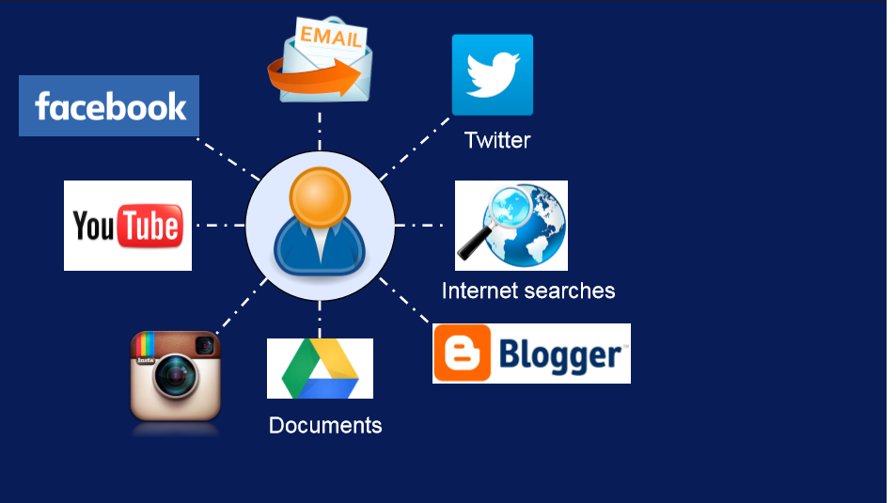
Source

Slide 11
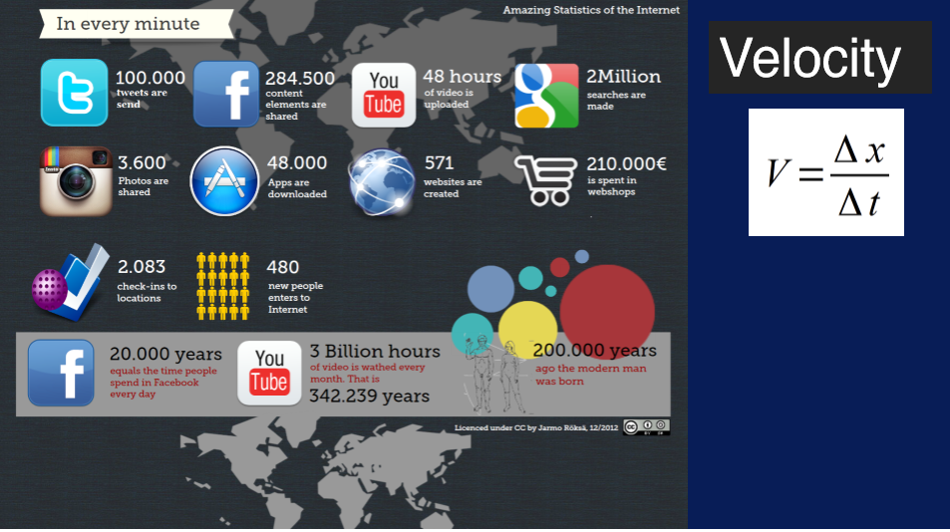
volume

Slide 12
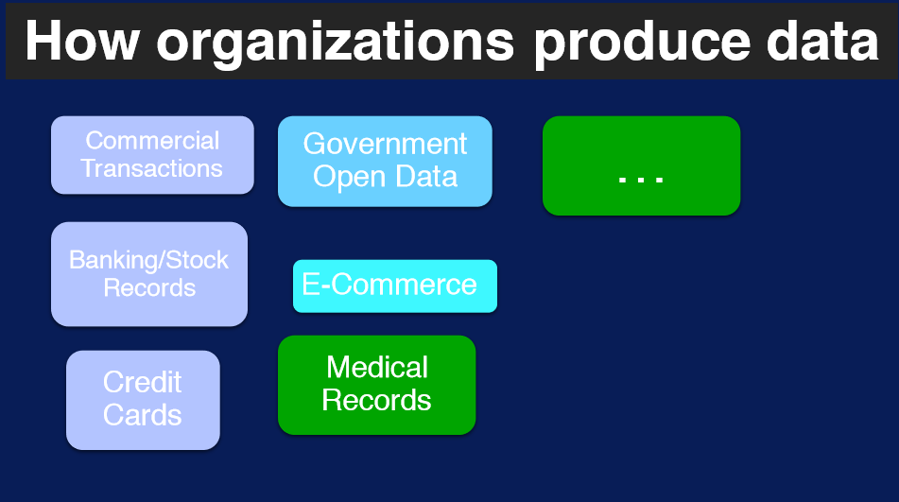

Slide 13
Characteristics of Big Data
Volume
Velocity
Variety
Veracity

Slide 14
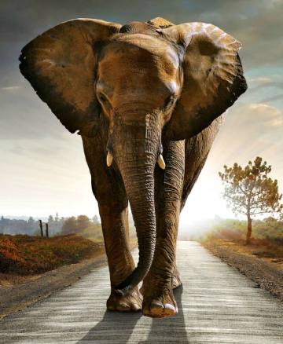
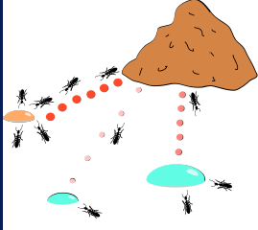
Volume
Represents size of big data
May come form large piece of data or collection of small data over a time

Slide 15
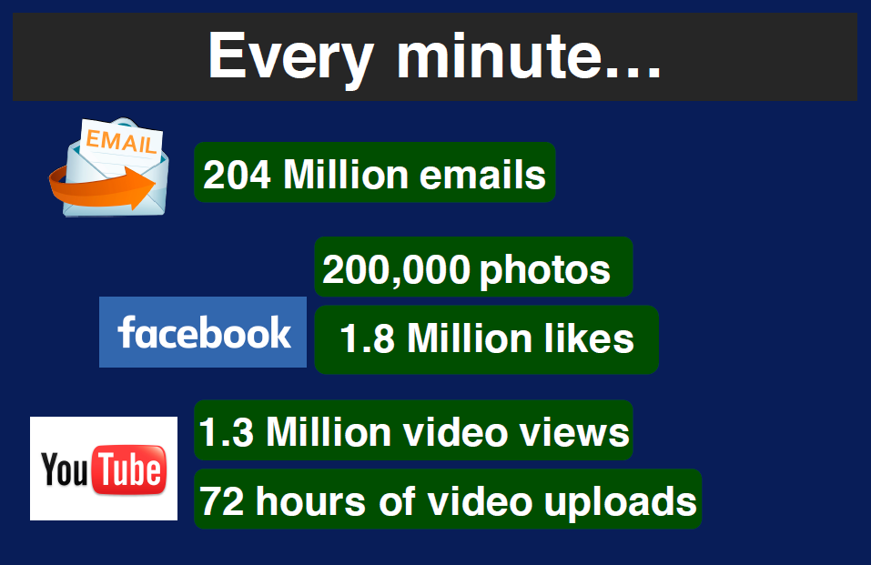

Slide 16
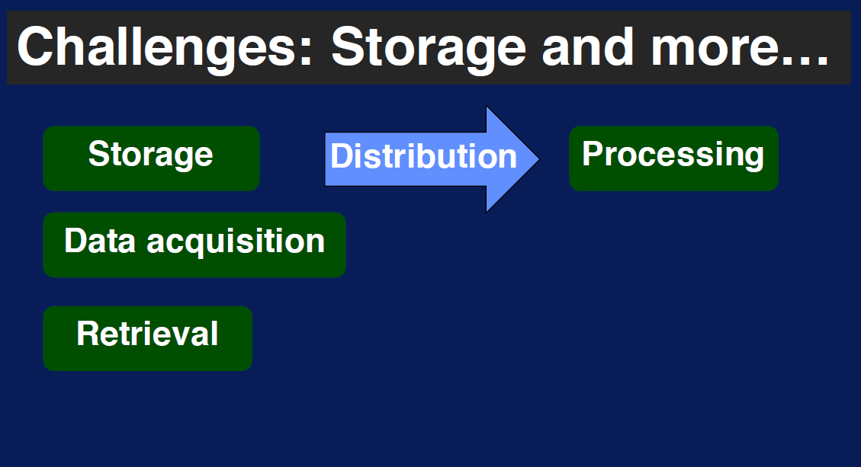

Slide 17
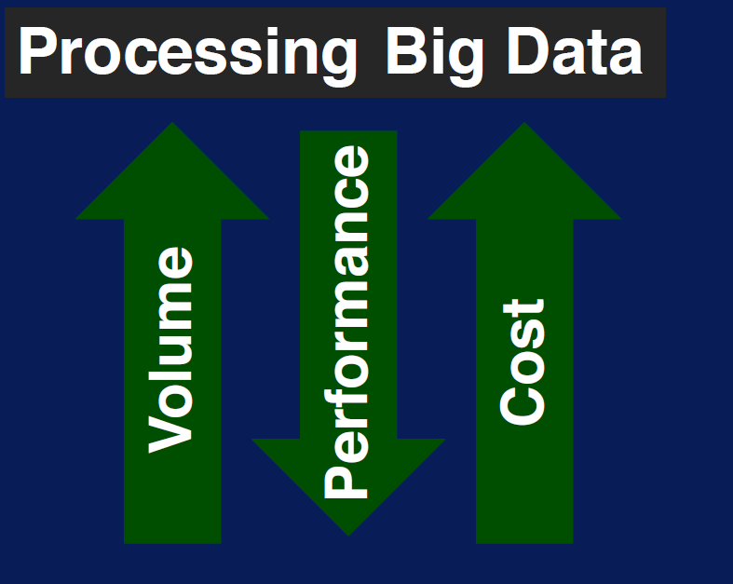

Slide 18
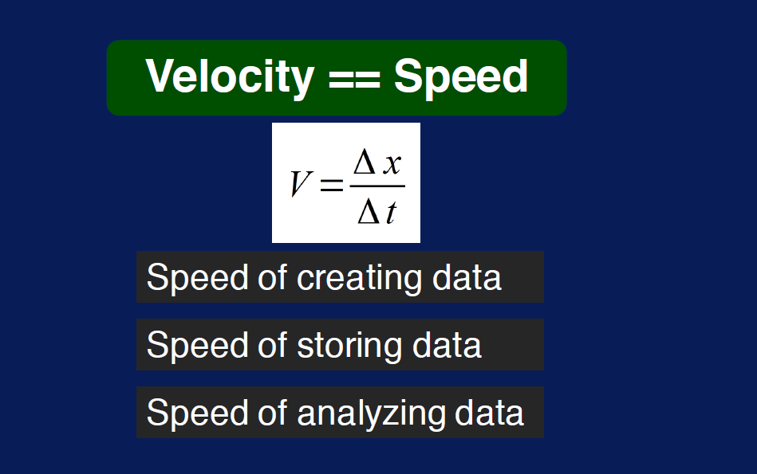

Slide 19
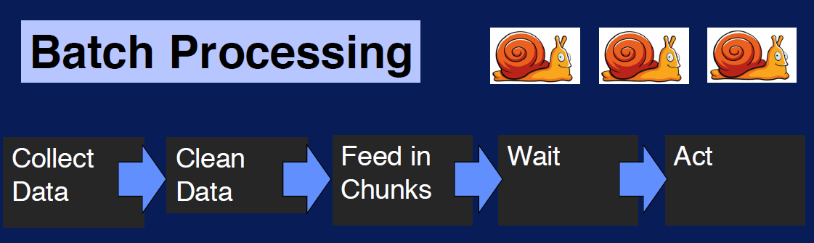
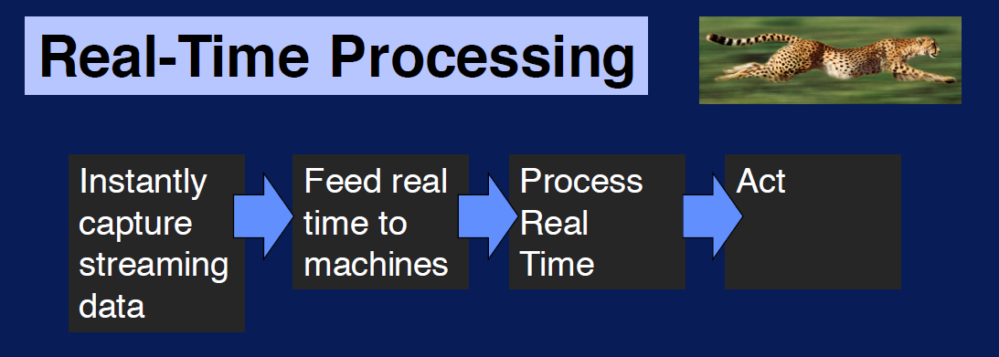

Slide 20
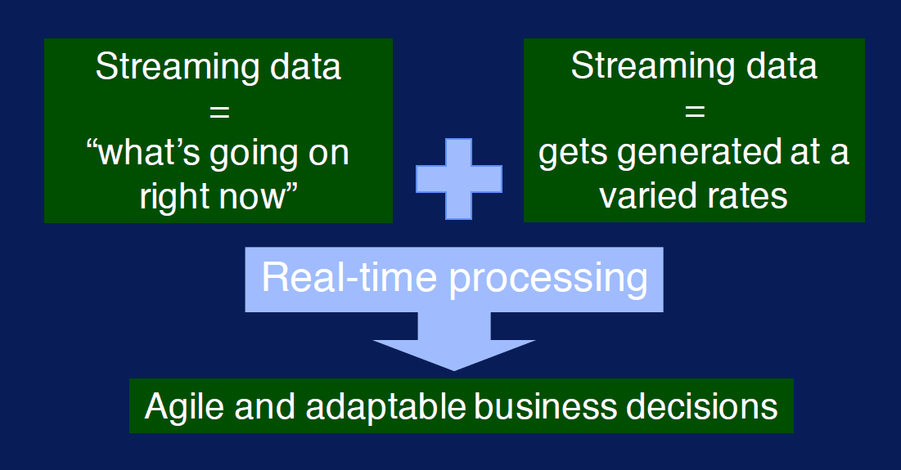

Slide 21
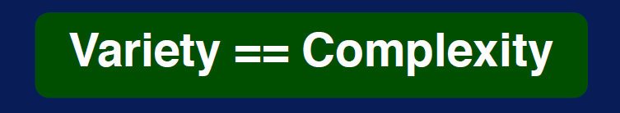
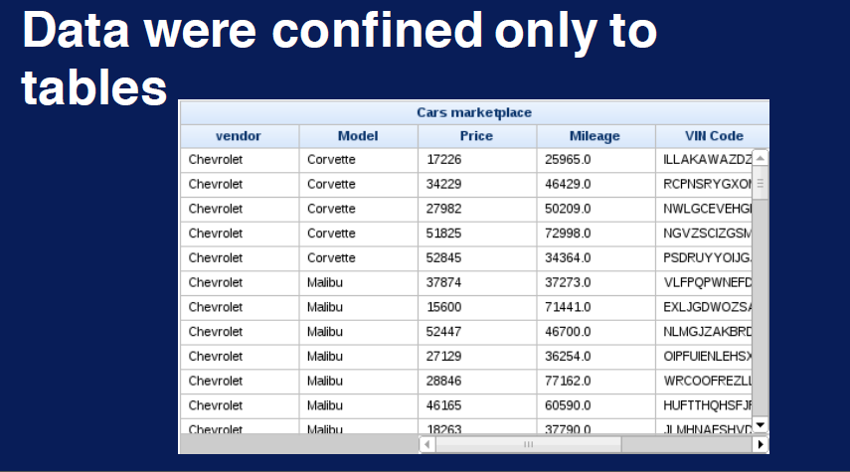

Slide 22
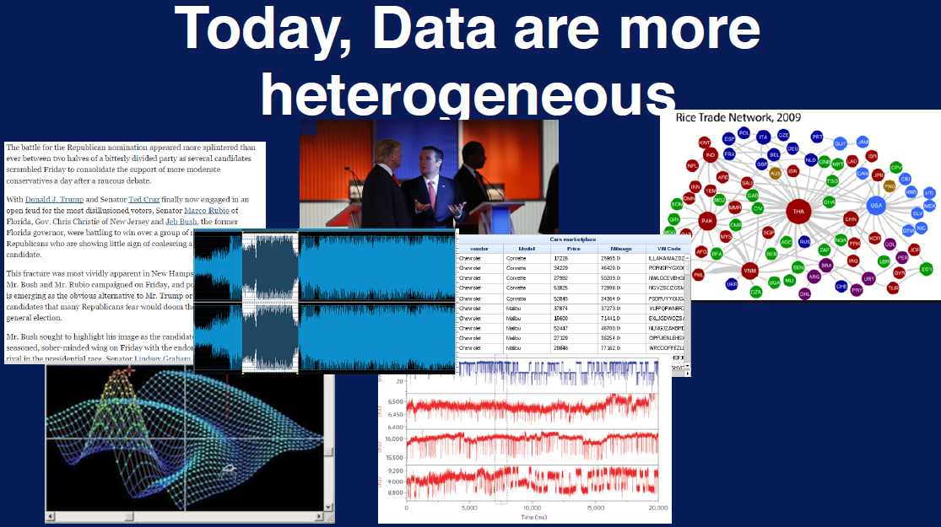

Slide 23
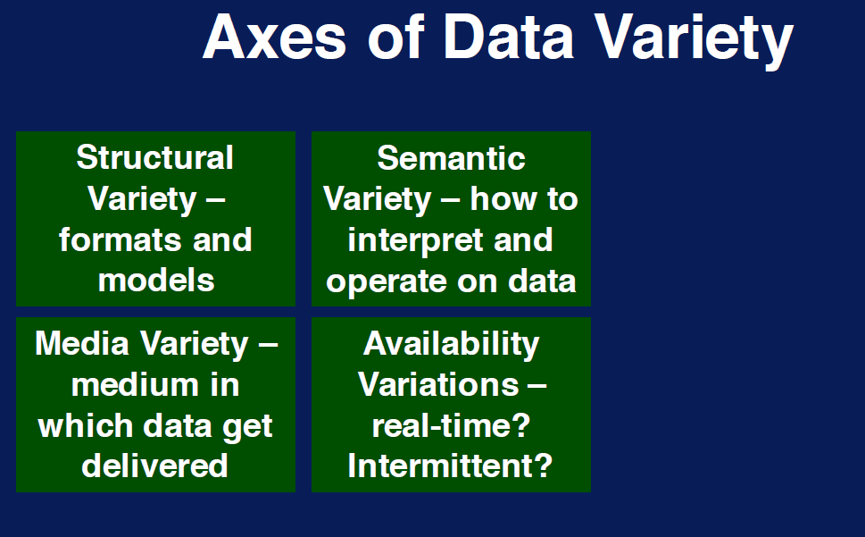

Slide 24
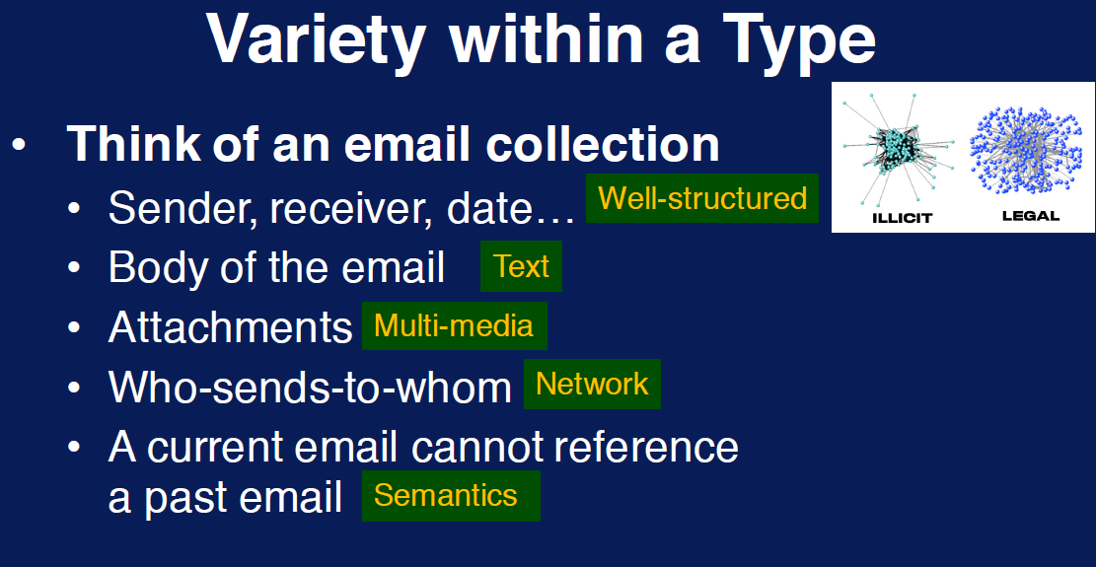

Slide 25
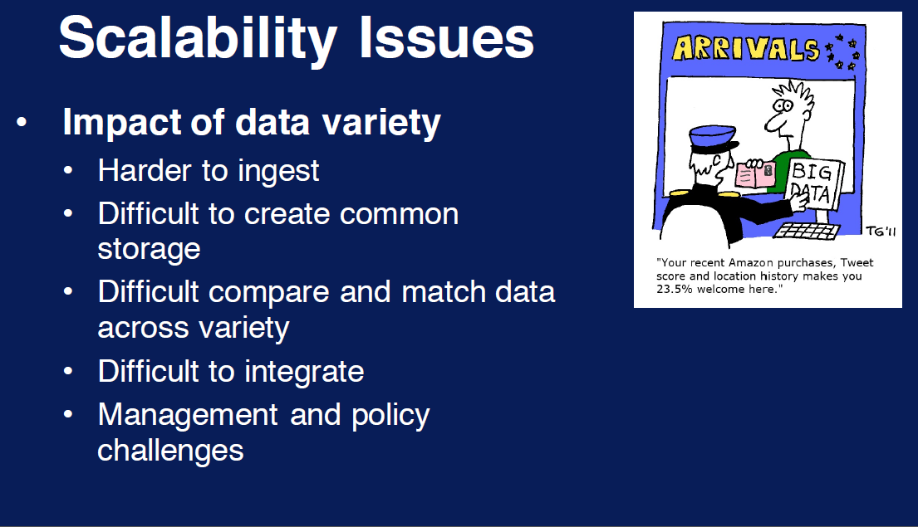

Slide 26
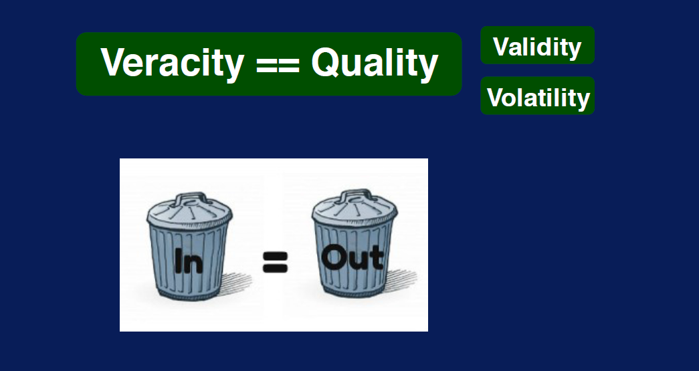
refers to the biases, noise and abnormality in data

Slide 27
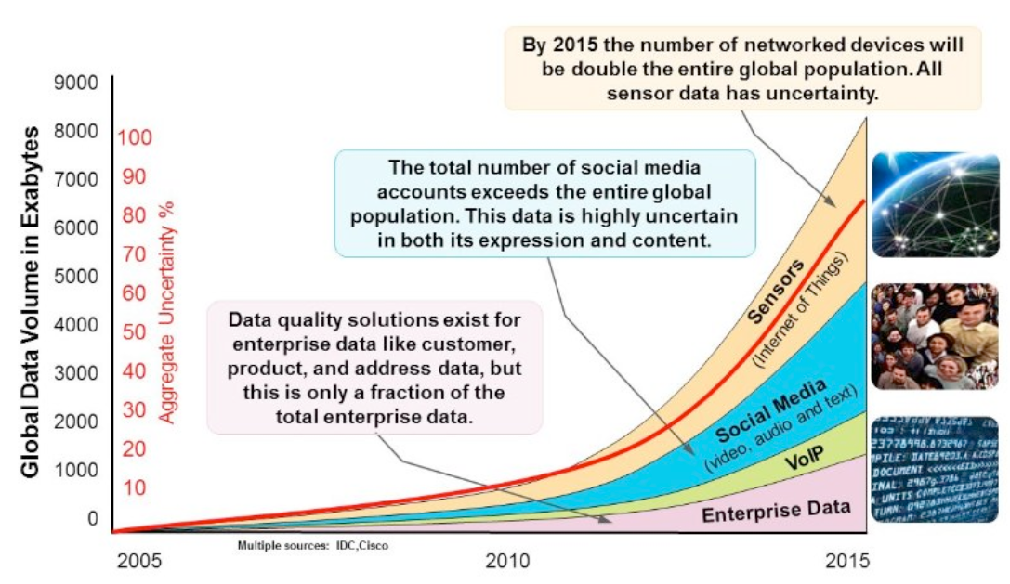

Slide 28
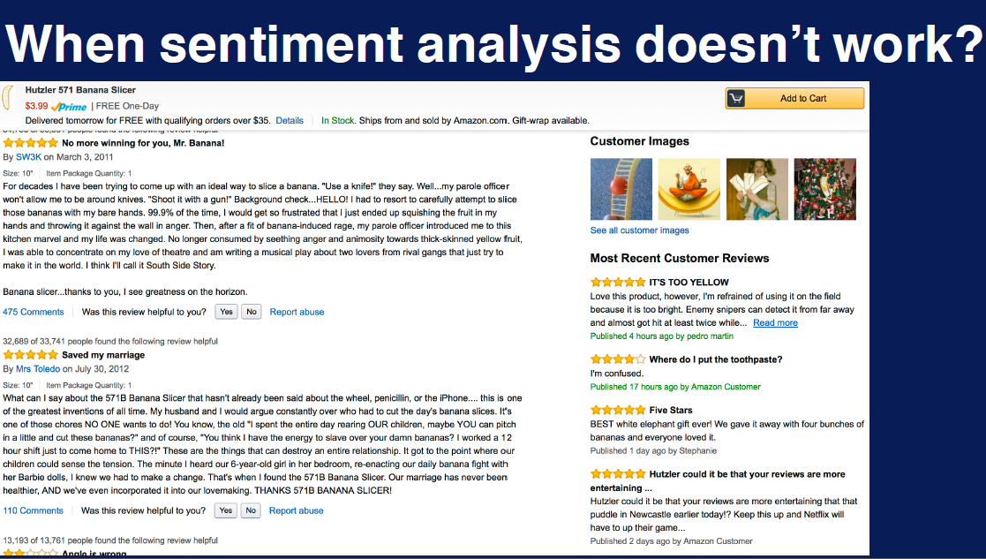

Slide 29
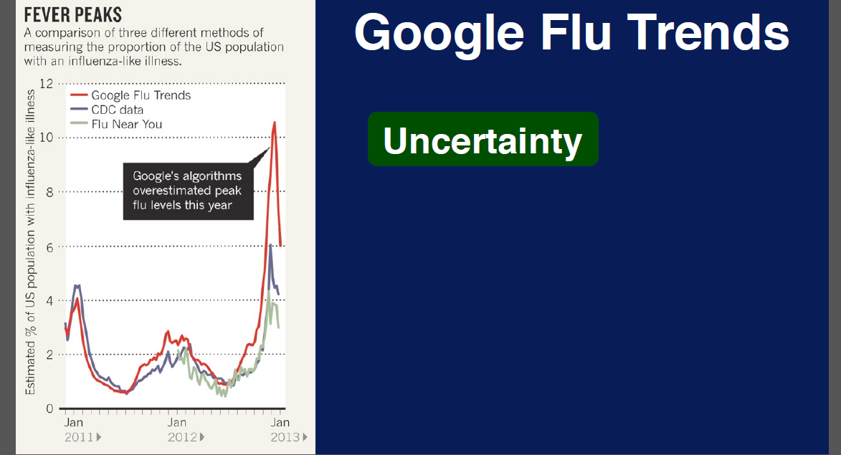

Slide 30
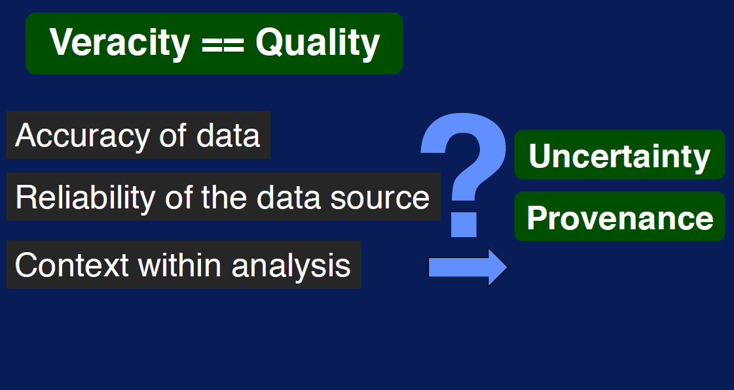

Slide 31
Major Challenges in Big Data
Scaling up and down Big Data according to Current Demand
Collecting and Integrating Massive and Diverse Datasets
Picking the Right NoSQL Tools
Maintaining Data Integrity, Security, and Privacy
Overcoming Big Data Talent and Resource Constraints
. . .
. . .

